Slide 1
Outline of Workshop
First thing: Introduction to Jupyter Notebooks Morning (pre-break):
Correlations arising from space-time properties: ‘autocorrelation’
Analysis of El Nino time series
Morning (post-break):
Time series analysis of Orange County ozone
Afternoon:
Extension of time series ideas to spatial analysis
Hands-on analysis of Oregon climate station data
Statistical prerequisites: at least one statistics course or some experience statistically analyzing data Notes on material:
Basic (linear) statistical models to demonstrate concepts
Combination of theory, software, hands on data analysis
Learn concepts using time series and then generalize to space
Run code as I present it in class, with some longer hands on exercises

Slide 2
Introduction to Jupyter
“Interacting Computing Environment” allowing code, plots, texts, equations, etc. to be created and shared
Requirements:
Python 2.7 (even if working in R)
Web application (Jupyter Notebook app in browser)
Language-specific Kernel (R or Python)

Slide 3
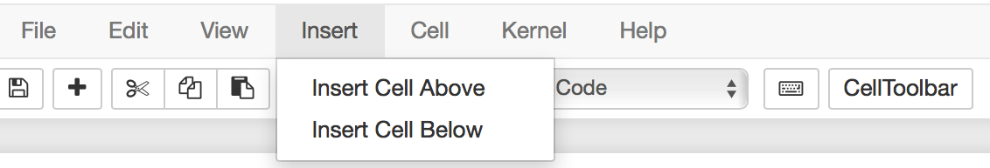
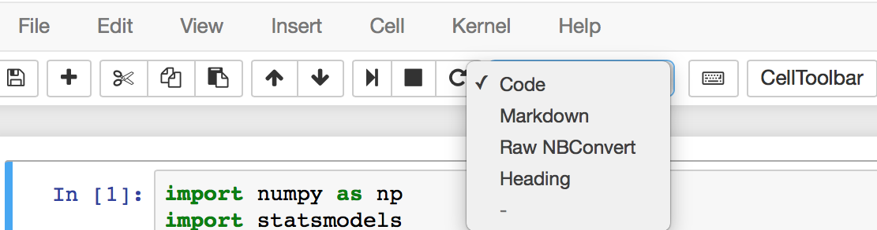
How to use Jupyter Notebooks
Everything goes inside ‘cells’. Create a cell:
Determine cell type:
Markdown for text, headers, equations;
Code for Python or R code that needs to be run (i.e. produces output).

Slide 4
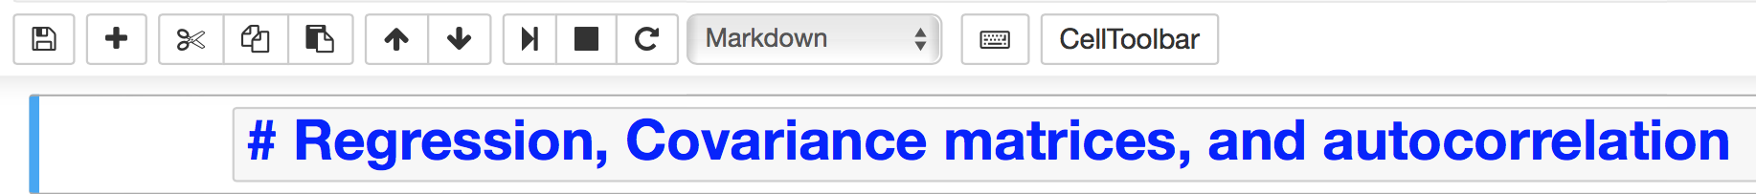
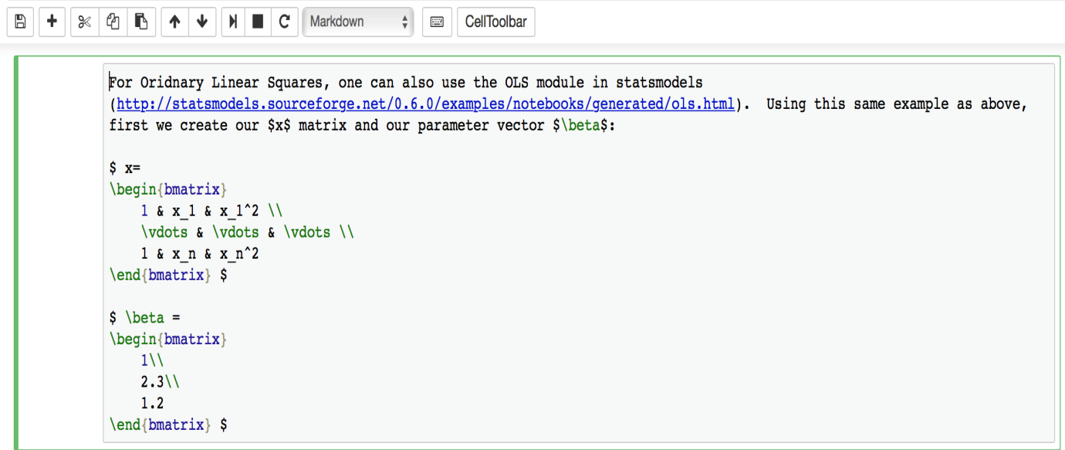
How to use Jupyter Notebooks (cont’d)
Convert Markdown to Header by simply using a # before the text and then run the cell:
Can also use Latex in Markdown:

Slide 5
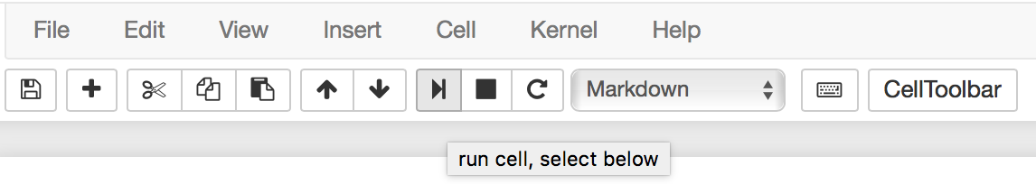
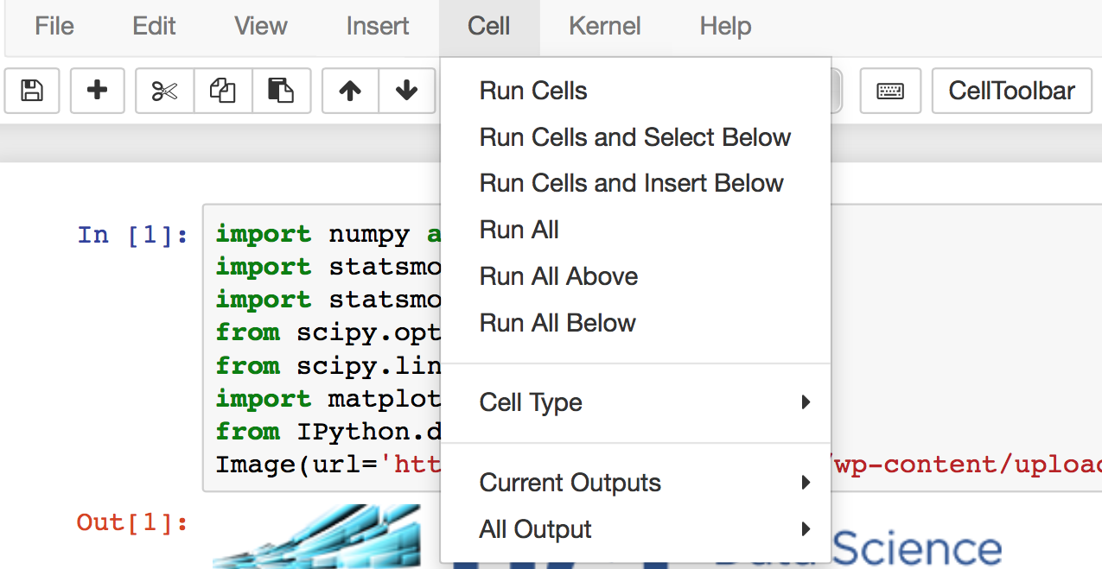
How to use Jupyter Notebooks (cont’d)
You can run each block of Markdown or code and get an output box:
Or run them all together:

Slide 6
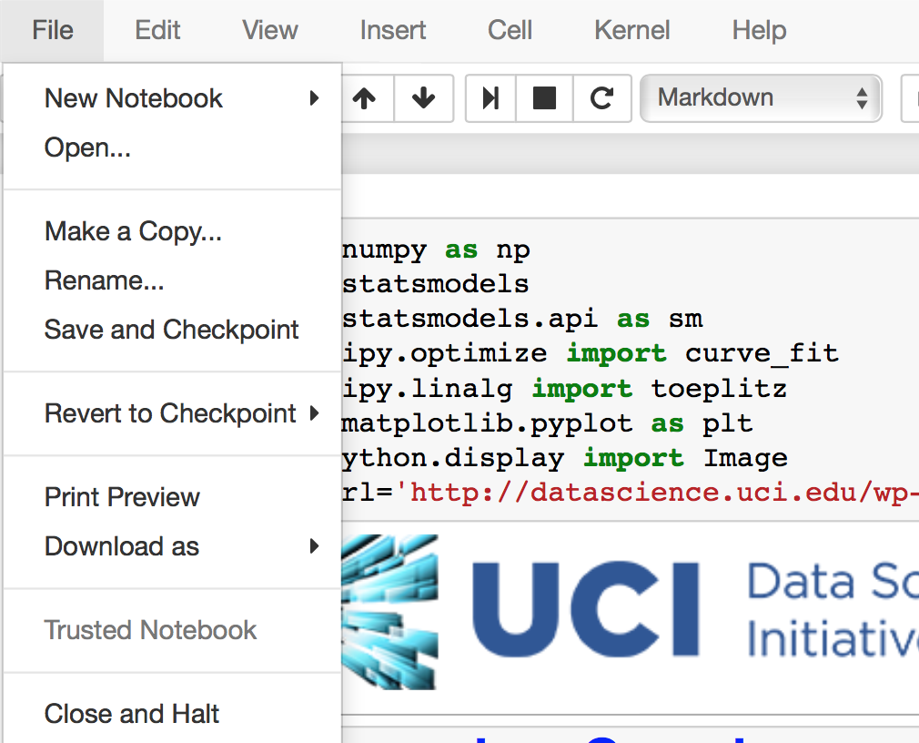
How to use Jupyter Notebooks (cont’d)
Finally, you can save a notebook when you’re done editing:
And close the kernel:
Notes:
Could insert the first SST plot here to make sure everything is working

Slide 7
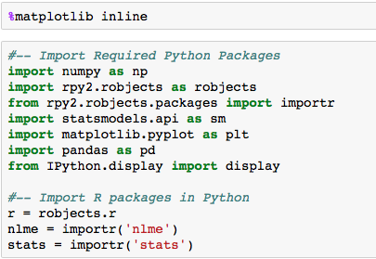
Note about required packages

Slide 8
Using R in Python: rpy2
Call R functions directly from Python.
Import R packages with importr from rpy2.robjects.packages
example nlme = importr('nlme')
Follow Python syntax for calling functions
gls() → nlme.gls()
Note dots in names become underscores in Python (e.g. arima.sim() → stats.arima_sim() )
Function inputs need to be R objects!

Slide 9
R functions in Python
Convert variables to R objects and pass to R environment:
robjects.globalenv["y"] = robjects.FloatVector(y)
R formulas are passed using r.formula(“formula”)
Note different R packages behave differently. E.g. robjects.r.lm() does not need r.formula() in the argument, where as nlme.gls() does. The return summary of robjects.r and nlme functions are also different.
The rest of the details will be discussed as we go along!

Slide 10
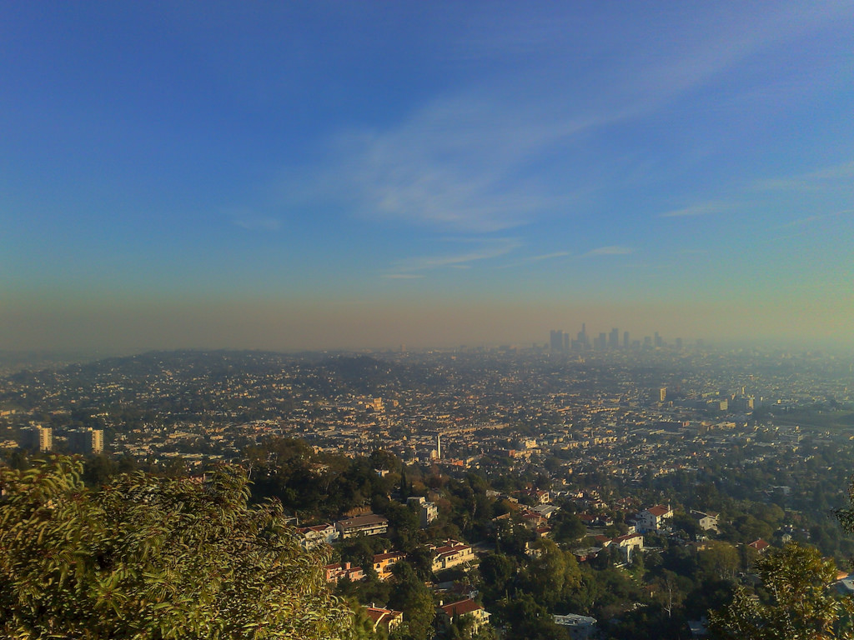







An Introduction to Spatial-Temporal Statistics
UCI Data Science Initiative Short Course Gregory Britten (gbritten@uci.edu), Yara Mohajerani (ymohajer@uci.edu)
Notes:
Workshop has been in the making for a while
Part of larger workshop effort in environmental statistics
Personal research in oceanography, Yara in glaciology, but interested in applied statistics and data science generally applied to environmental science
Not Bayesian at all
Common goals include analysis of trends, dynamics, statistical significance

Slide 11
Is there a statistical trend in observed air quality? Are times of the year systematically worse? What environmental factors contribute to the trend?
Using environmental datasets but concepts apply across disciplines
Notes:
Air quality of primary concern in Southern California
May want to ask these questions of data and determine the statistical strength of the evidence
Measure this field for concentrations which will exhibit particular statistical properties, regional trends, ‘clumpiness’, statistical relation to other variables.
Aligned with goals of applied statistics
We’ll talk about the statistical processes that generates

Slide 12
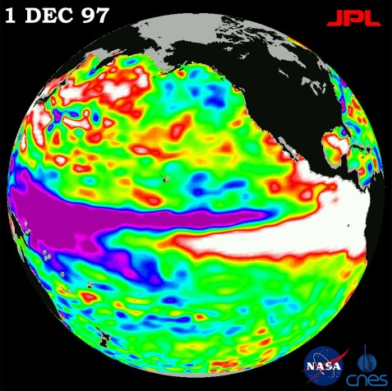
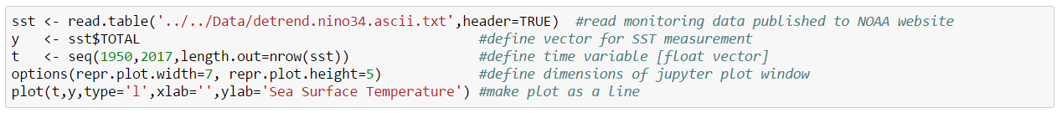
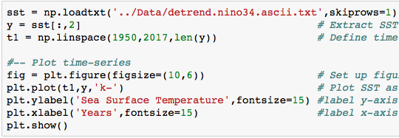
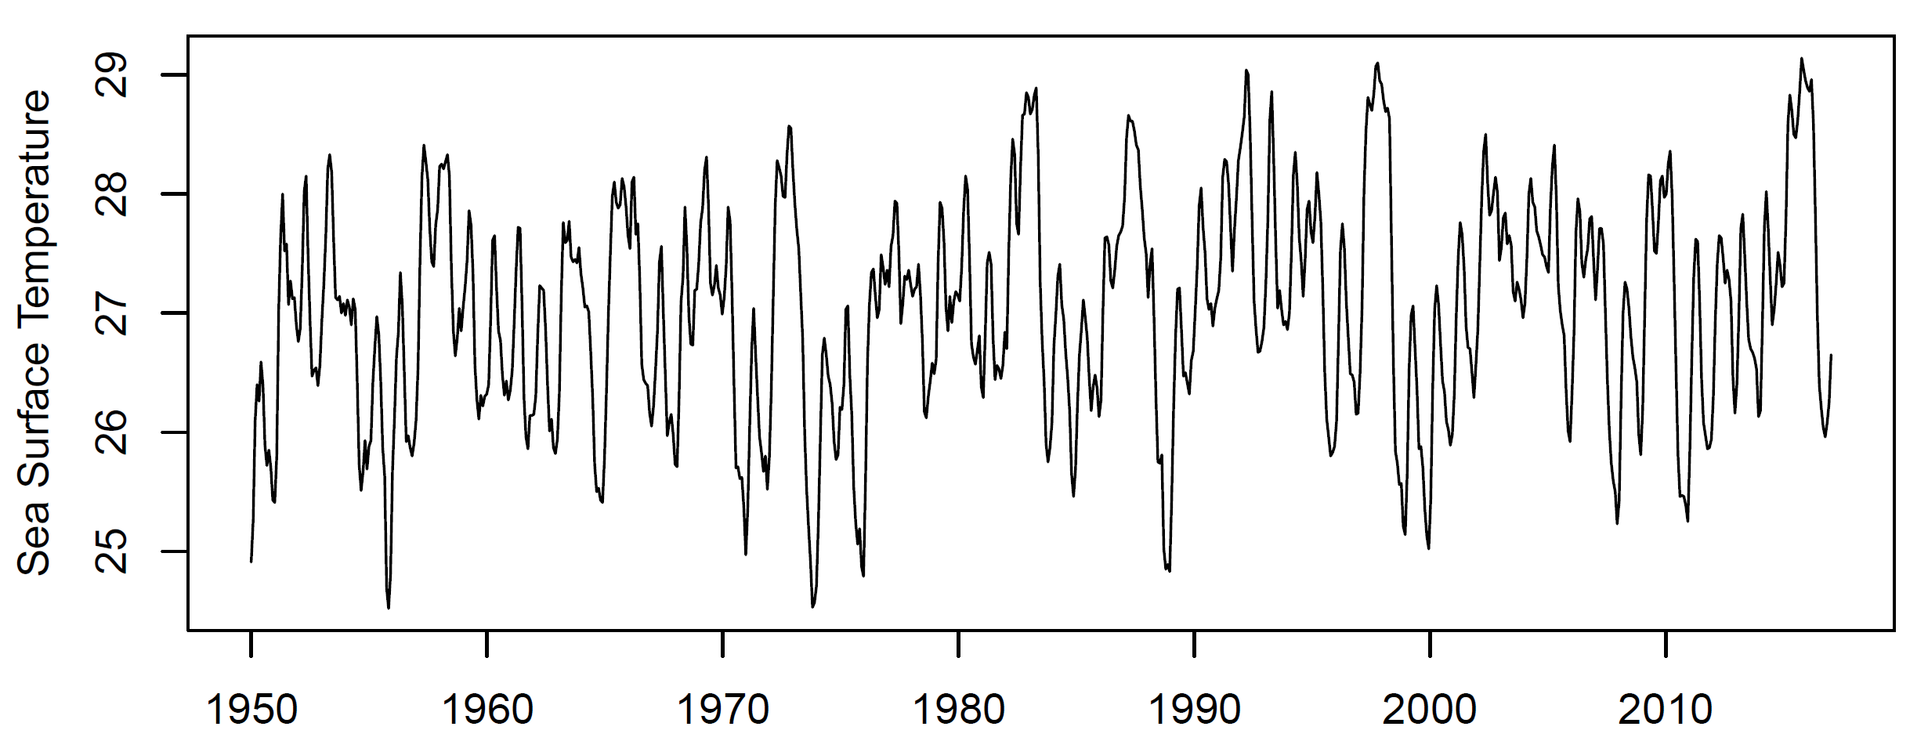
El Nino index: SST off the coast of Central America
Autocorrelation: ‘correlation with self’; measurements closer in time are more correlated (similar in value)
Periodicity: The earth spins and orbits the sun! Seasonal, daily, and other climate cycles are fundamental and seen in many datasets
Sea Surface Temperature
Notes:
Take a look at a representative environmental time series
Clumpiness in time,
Downloaded from NOAA dataset
Much like the ozone case, we might be interested characterizing the regional variability, the clumpiness, the trend, etc.

Slide 13
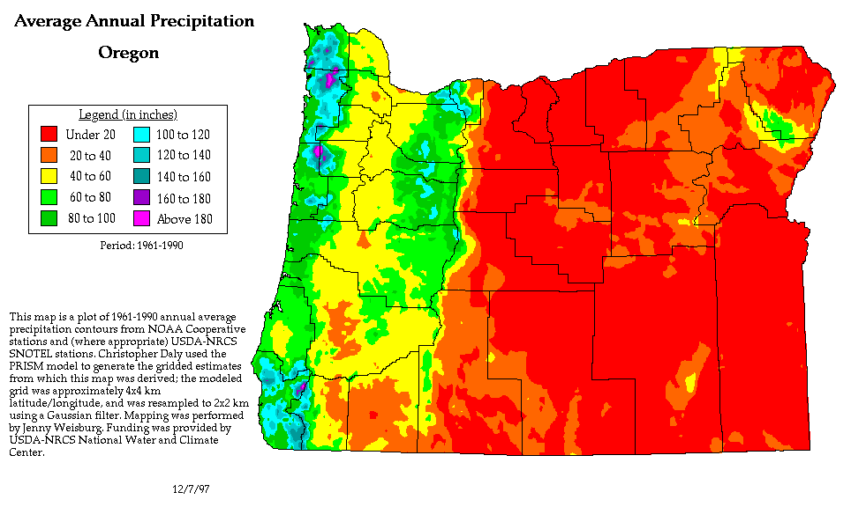
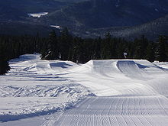
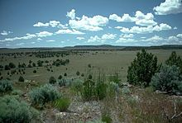

Slide 14
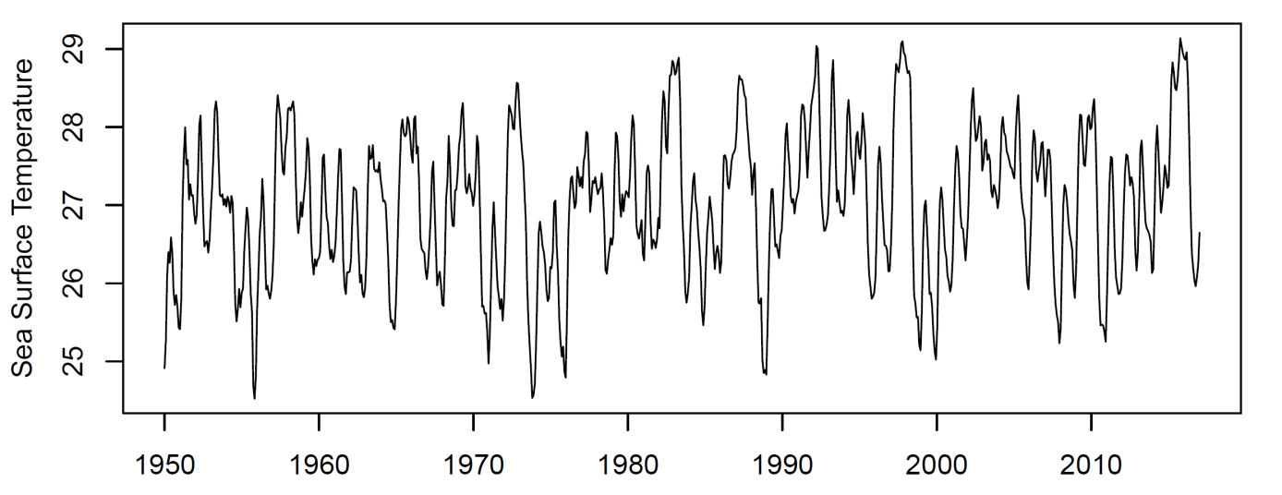
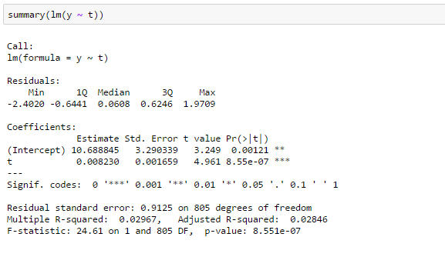
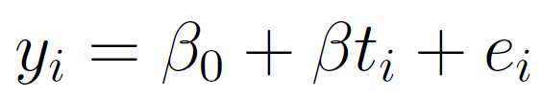
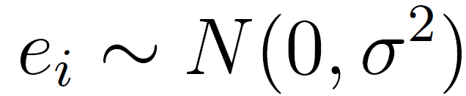
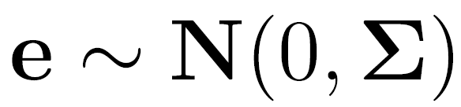
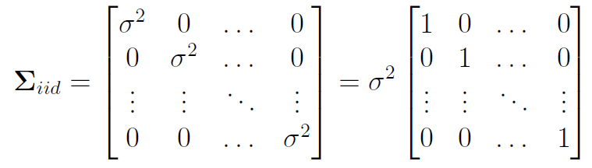
Is there a trend? ..a first attempt
Indicates strong evidence Alert the press, the ocean is warming!

Slide 15
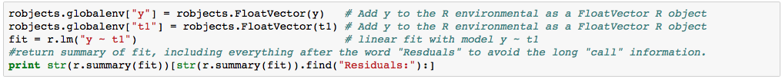
Remember we have to convert the Python objects to R objects and pass them to the R environment before calling them.
Note in this case we have pass the formula just as a string, but other packages may not be able to interpret formulas as strings, in which case we have to use r.formula().
Also note the summary of r.lm() returns a lot of excessive “call” info so we cut off the output before the word “Residuals”.

Slide 16
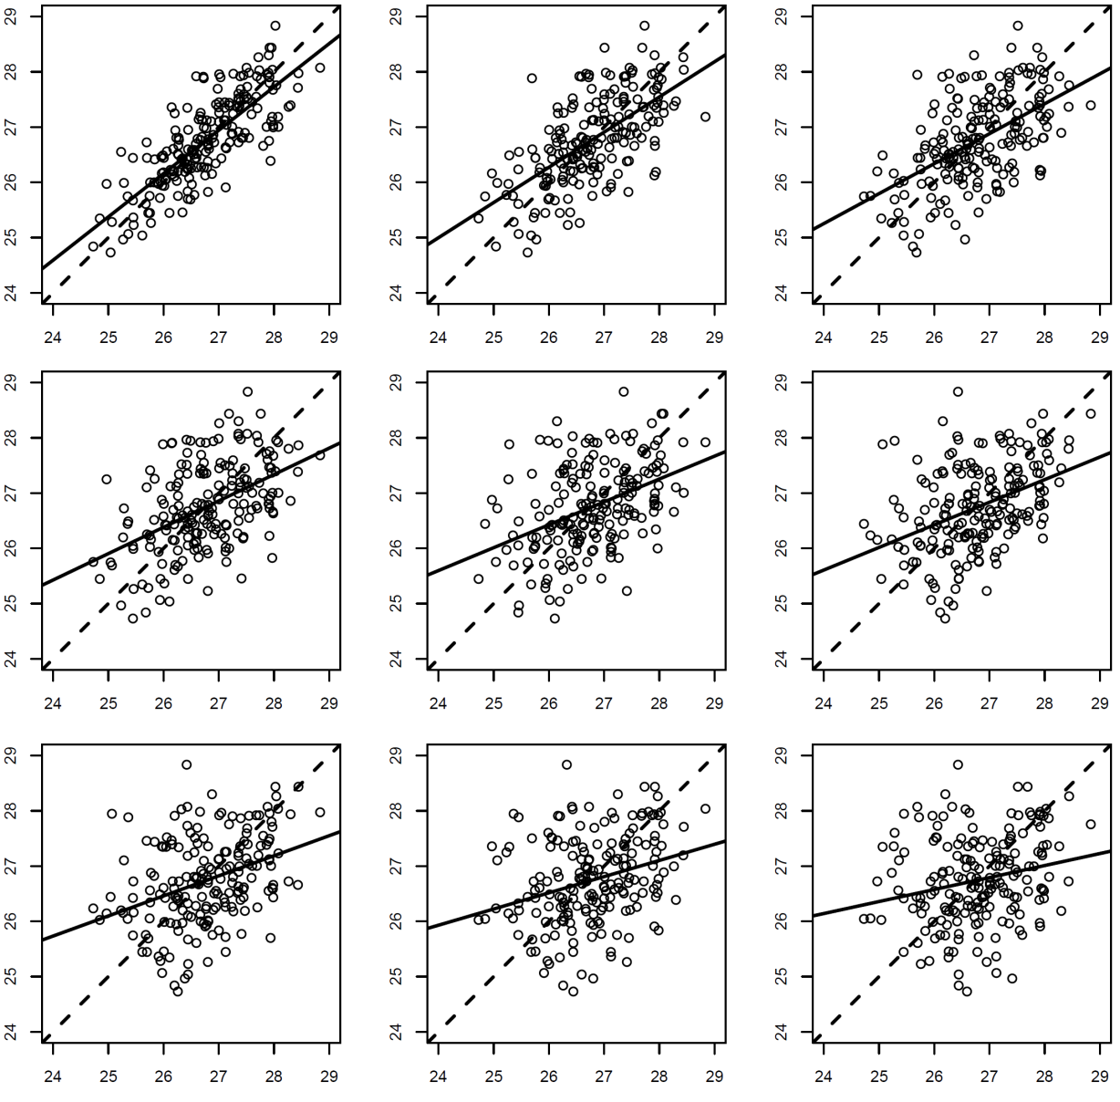

What Generates the Pattern? Key concept: autocorrelation as a function of lag
Places closer to one another are more similar => autocorrelated
Correlation falls away as a function of temporal distance, or lag
‘Autoregressive’ pattern

Slide 17
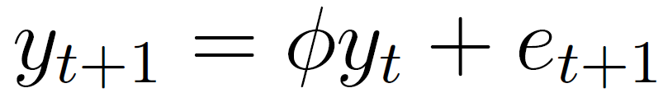
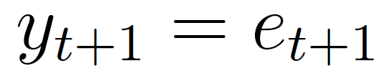
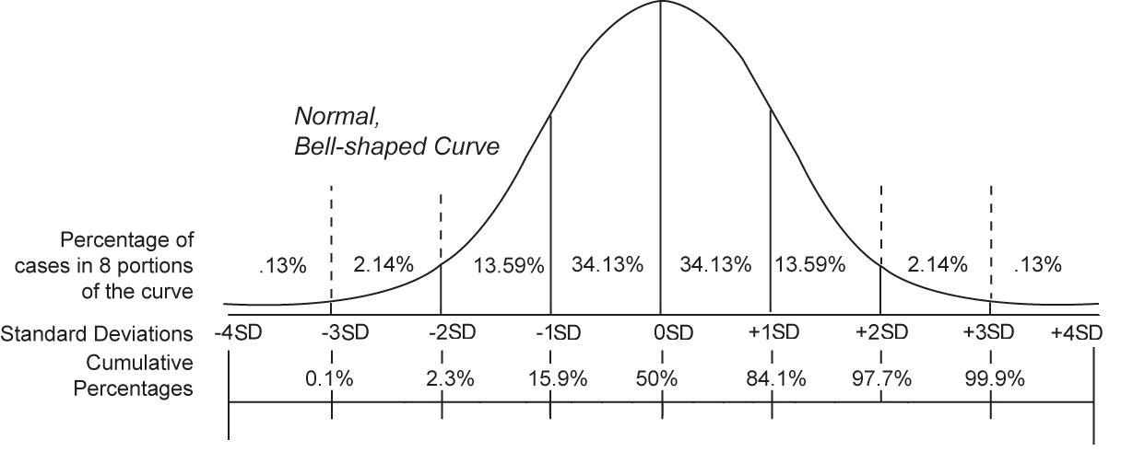
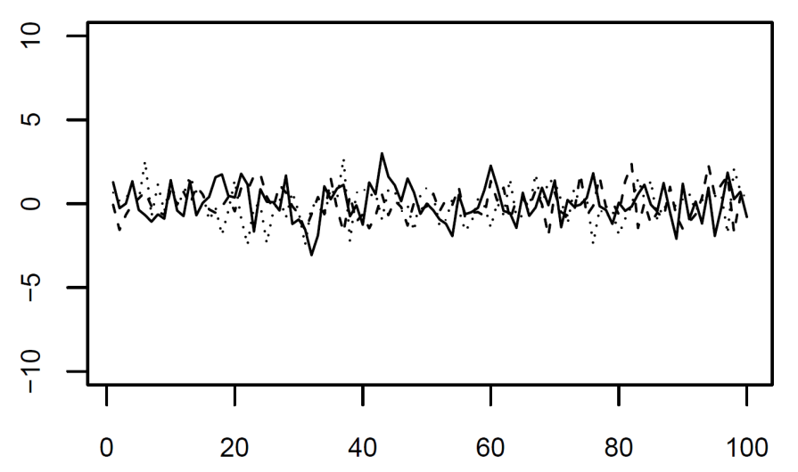
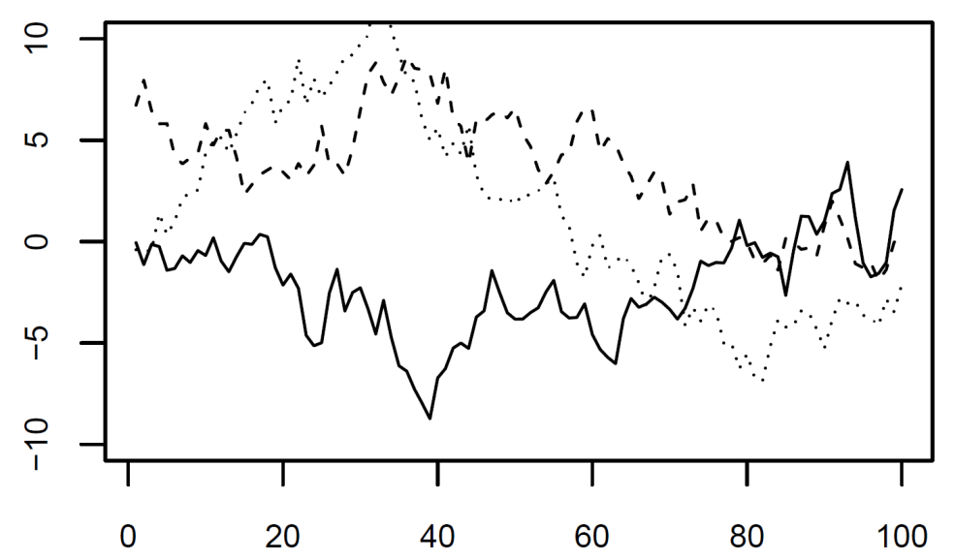
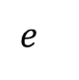
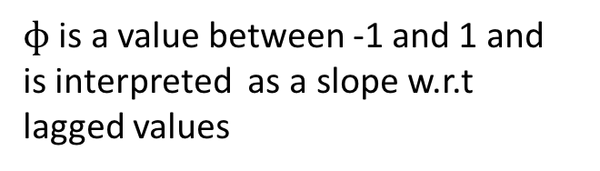
Autoregressive models and the concept of stochastic realization
*autoregressive model
$ɸ$ is a value between -1 and 1 and
is interpreted as a slope w.r.t
lagged values
$$e$$

Slide 18
Autoregressive models and the concept of stochastic realization
*autoregressive model
$ɸ$ is a value between -1 and 1 and
is interpreted as a slope w.r.t
lagged values
$$e$$

Slide 19
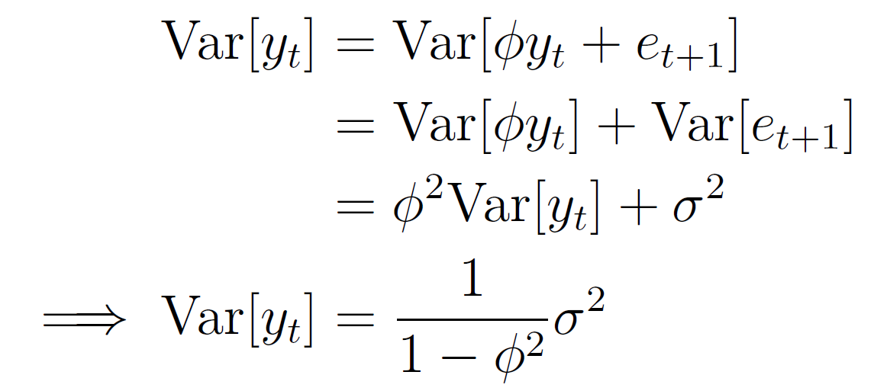
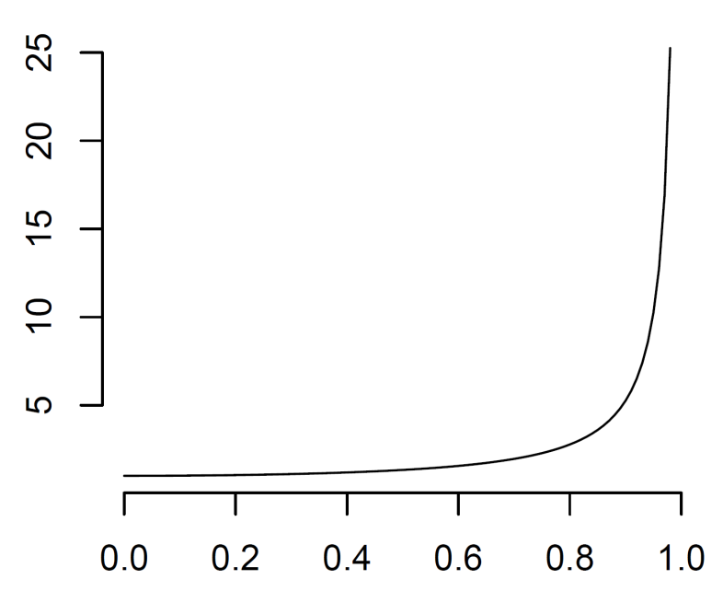
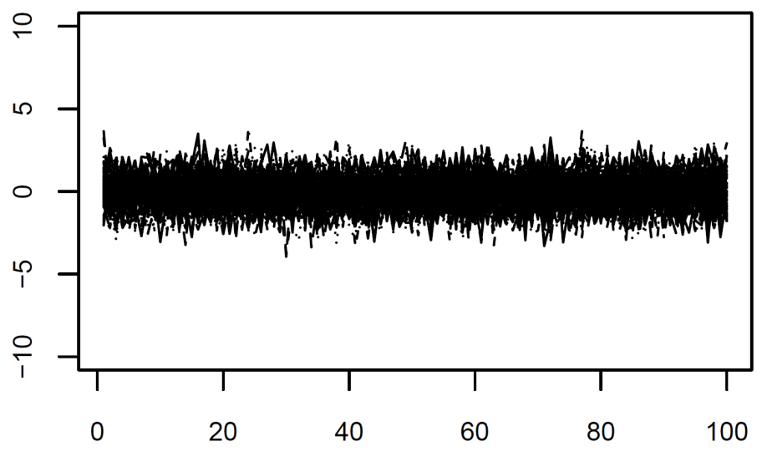
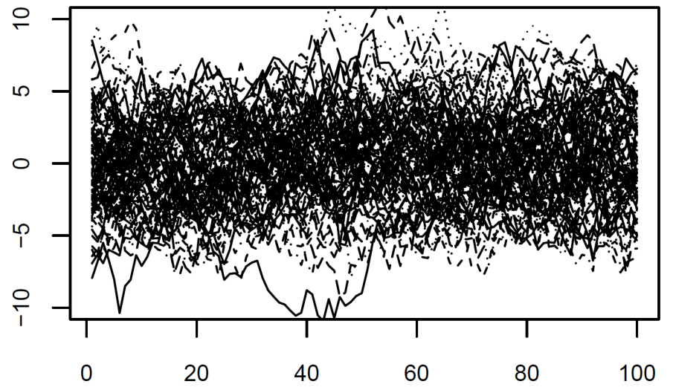
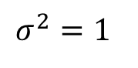
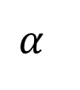
Expected variance of a temporal process increases with autocorrelation
$$σ^{2}=1$$
$$α$$

Slide 20
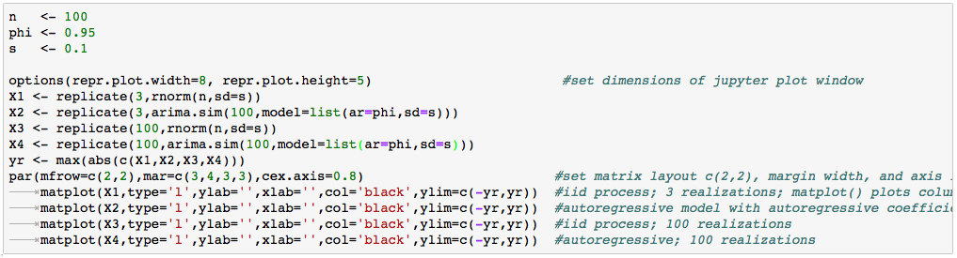
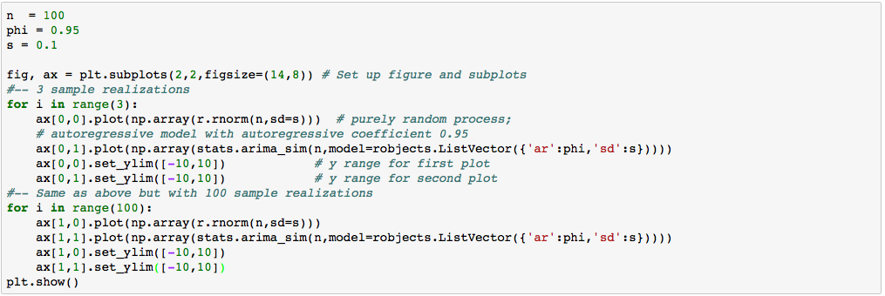

Slide 21
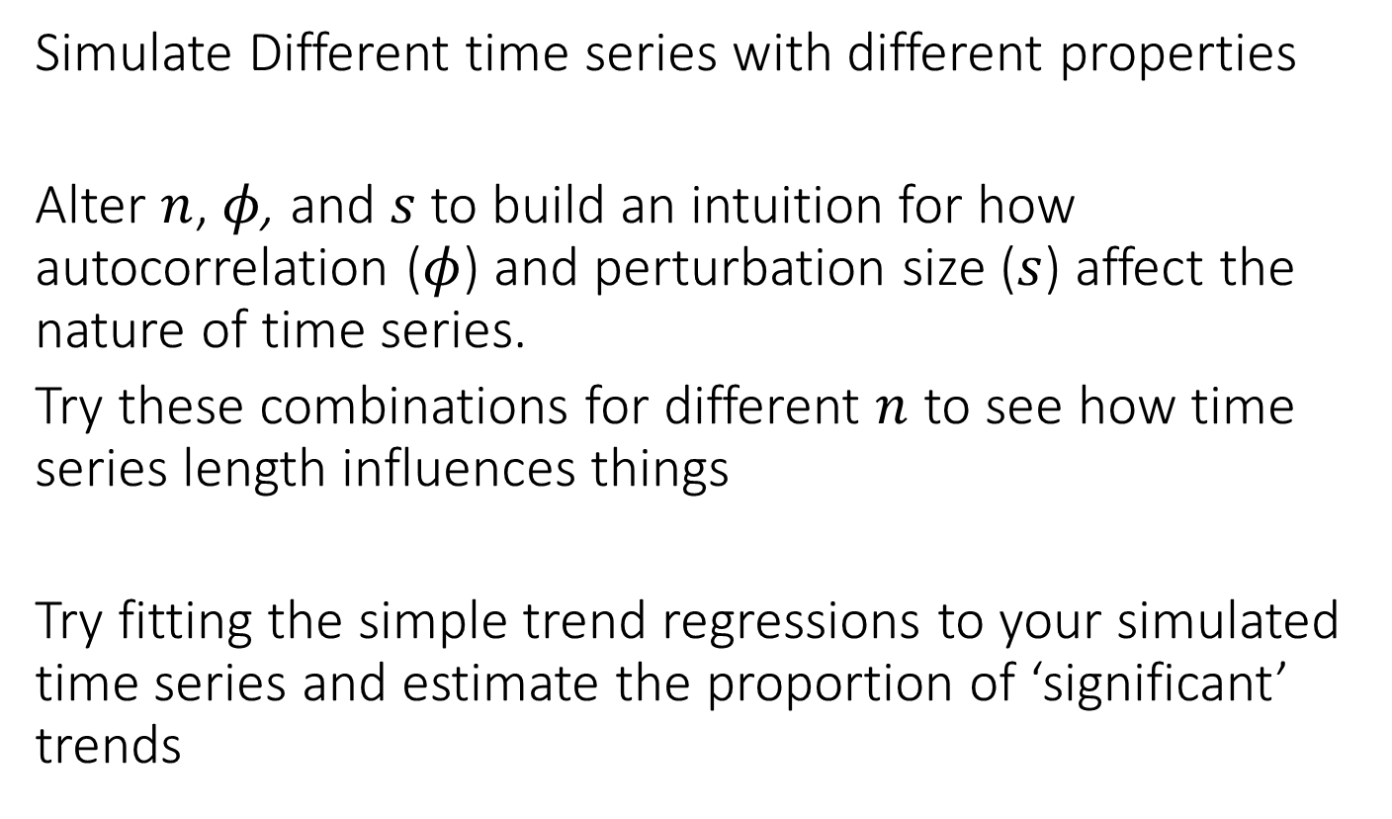
Exercise
Simulate Different time series with different properties
Alter $n$, $φ$, and $s$ to build an intuition for how autocorrelation ($φ$) and perturbation size ($s$) affect the nature of time series.
Try these combinations for different $n$ to see how time series length influences things
Try fitting the simple trend regressions to your simulated time series and estimate the proportion of ‘significant’ trends

Slide 22
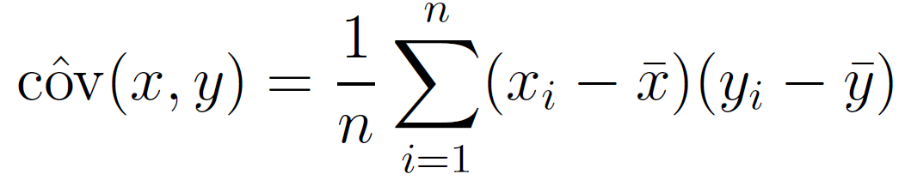
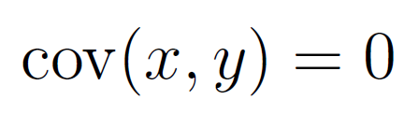
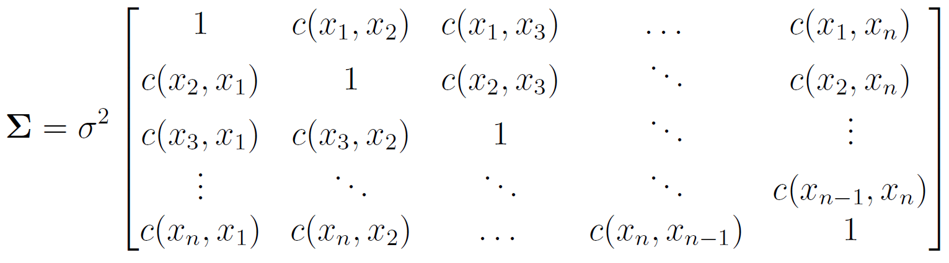
Modeling autocorrelation in stats models
Covariance between two ‘random variables’:
Independence:
Same idea applied to time series; covariance applied to lag:
Now the correlation matrix is filled in with correlations between time intervals:

Slide 23
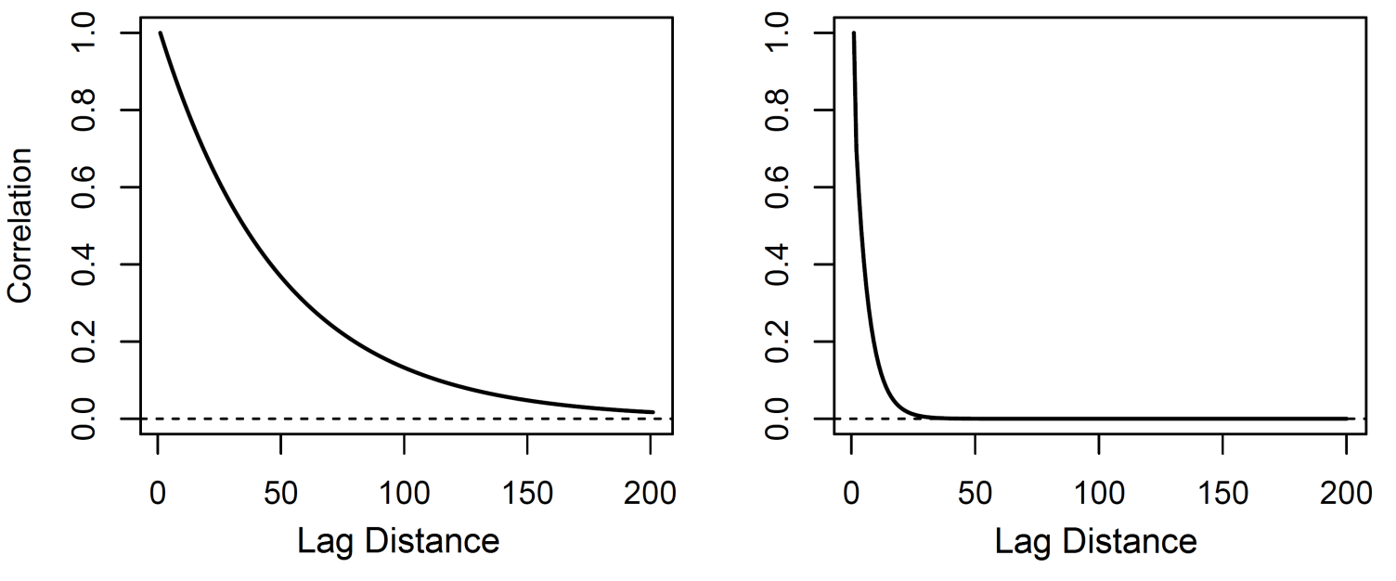
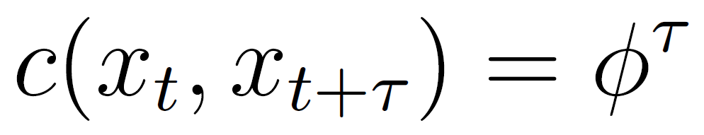
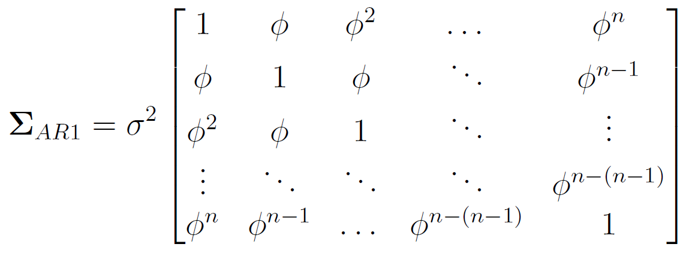
Autocorrelation function to ‘fill-in’ the correlation matrix
The autocorrelation function is a curve that provides a value for the expected correlation as a function of lag, which can be in time or space
We’d like to account for spatial correlation when statistically analyzing data because it affects confidence intervals, p.values, posterior probabilities..
* AR1 correlation function

Slide 24
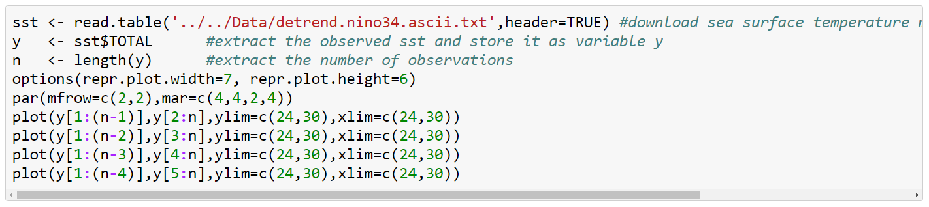
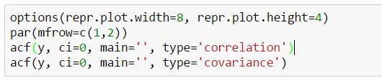
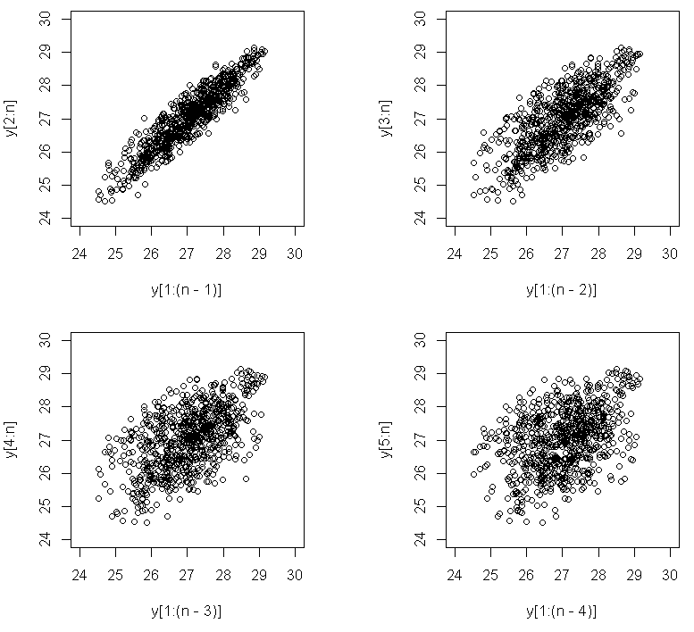
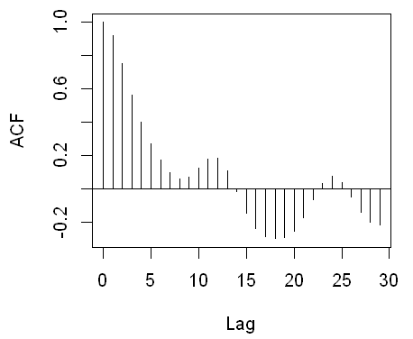
The empirical autocorrelation function

Slide 25



Slide 26

Fitting models to the empirical autocorrelation function

Slide 27


Slide 28






The likelihood makes all the difference
‘Best’ (min. variance) unbiased estimate for regression coefficients
For correlated data
BLUE regression coefficients with autocorrelation
*nice analytical expressions for linear regression, idea applies equally to nastier functions

Slide 29



Fitting a Model with Temporal Autocorrelation
Much weaker evidence!

Slide 30


Dataset #1: Ozone time series at single station
What’s Going on with our Air?
EPA Air Quality Station Data, Orange County

Slide 31

Time series of ozone data
Days since September 7th 2001

Slide 32

Variables lat ≡ latitude [degrees] lon ≡ longitude [degrees] n ≡ number of samples [#] ozone ≡ mean daily ozone [ppb] ozone_max ≡ max daily ozone [ppb] hour_max ≡ hour when max occurs [hours from 12AM]
aqi ≡ air quality index [dimensionless] pressure ≡ atmospheric pressure [inHg] humidity ≡ [relative %] temp ≡ [Fahrenheit] windsp ≡ [m/s] winddir ≡ [degrees]

Slide 33



Simple Trend Analysis

Slide 34


Slide 35



Harmonic regression
Include a periodic covariate with frequency $ω$ and phase $ζ$
This is nonlinear in the parameters, rewrite using the double-angle formula :
Now we model any frequency with arbitrary phase using linear regression with

Slide 36



Harmonic regression
Note: the highest resolvable frequency is half that at which observations are resolved (need two points per cycle to capture highs and lows), known as ‘aliasing’

Slide 37


Slide 38



Time Series Decomposition

Slide 39


Slide 40
Exercise
Decompose other variables in the ozone dataset into trend, seasonal, noise components
Do any variables have a significant trend after controlling for seasonality and autocorrelation?
Try looking for other periodicities in the data, recall you need two observations per cycle

Slide 41



Time series regression

Slide 42


Slide 43



Standardizing variables for interpretation
*notice the R2 did not change

Slide 44


Slide 45
Exercise
Fit a model that includes a trend, seasonal term, and one covariate, with an autoregressive correlation matrix
Standardize the variables and rank them in terms of magnitude of standardized ‘effect size’, as well as % uncertainty (s.e./effect size)
Try fitting additional variables in the data (e.g. can you relate temperature to windsp after controlling for seasonality and autocorrelation?)

Slide 46



Simple Model Selection
R² always increases with the number of parameters for linear models
The ‘best’ model is the one that minimizes the BIC or AIC
R and Python readily provide these quantities
More interpretable than p.values for model comparison

Slide 47



Model Selection

Slide 48



Model Selection

Slide 49
Exercise
Try to find the single best predictor of mean daily ozone concentration, after correcting for seasonality and autocorrelation
After standardizing variables, fit a few multiple regressions with different input variables rank the models in terms of BIC
Try modeling other variables beyond ozone

Slide 50
Generalizing autocorrelation to space
*spatial distance for spatial models is treated the same as temporal lag for time series models

Slide 51


Temperature and Precipitation
Climatology of Oregon

Slide 52

Note on packages for the afternoon

Slide 53

Generalizing the covariance matrix
d is the distance (or spatial lag) between points i,j
(can be Euclidean, or calculated from a map projection)
We use the exponential correlation numerical reasons, but it closely approximates the autoregressive model

Slide 54



Simulate spatially autocorrelated data

Slide 55


Slide 56



Simulate spatially autocorrelated data

Slide 57


Slide 58
Exercise
Try generating spatial patterns with different decorrelation parameters and look at the resulting patterns

Slide 59



Spatial interpolation
Often want to make predictions to ‘fill in the map’ based on the data properties
Krigeing considers a linear model and Normally distribution observations

Slide 60








Given $γ(d)$, optimal weights for a new location are given by least squares regression
$γ$ is generally unknown so we use numerical optimization *weights are ‘BLUE’ according to the ‘Gauss-Markov theorem’, special case of ‘Gaussian process’
*Krige 1951. A statistical approach to some basic mine valuation problems J. Chem. Metal. Min Soc. South Africa

Slide 61




Like before, we fit functional forms to the empirical values
Observations are binned into pairwise distance bins, with $N_{d}$ pairs of observations in the bin

Slide 62


Slide 63


Numerical variogram optimization in R
Packages properly weighs by the number of observations in each bin, so points far away have lower influence

Slide 64


Slide 65


Spatial Interpolation

Slide 66

Notes:
Note different way of doing expand_grid than the first time (to showcase different ways)

Slide 67
Exercise
Interpolate other variables in the data by first estimating the empirical variogram and then optimizing a functional form
Try defining a new variable (e.g. representing the difference in temperature between July and January, and interpolate that variable)
Compare empirical variograms to understand differences in spatial properties of signal

Slide 68


Spatial Regression
It appears the addition of elevation does not help the model according to the BIC score

Slide 69


Slide 70



We can fit a variogram to the predictions

Slide 71


Slide 72




Slide 73



Fitting alternative variogram functions

Slide 74


Slide 75





Model Selection

Slide 76


Slide 77
Exercise
Find the multiple spatial regression that minimizes the BIC
Krige the predictions by estimating the empirical variogram, then fitting a functional form

Slide 78
Wrapping Up
We hope you now:
Understand how patterns in data are generated via autocorrelation
How to statistically model spatial-temporal correlation and periodicity within basic stats model
Know R packages for key statistical models, and Python implementation
Final remarks:
Datasets relatively small, models relatively simple, extended workshop in the works
Hackathon coming up

Slide 79

Rain Shadows https://en.wikipedia.org/wiki/Rain_shadow
Construct a new variable

Slide 80
ADDITIONAL SCIENCE EXERCISE: Derived spatial variables
Given what you’ve just learned about rain shadows, construct a new spatial variable that may capture the effect of the rain shadow in Oregon (hint: where is water coming from?)
Using the statistical tools you’ve learned today, test the rain shadow variable in a statistical model and determine whether it is associated with Oregon precipitation patterns after controlling for the spatial-temporal properties of the data

Slide 81
Additional Resources
Cressie 2015. Statistics for spatial data. John Wiley & Sons.
Cressie and Wikle 2015. Statistics for spatio-temporal data. John Wiley & Sons.
Pinheiro and Bates 2006. Mixed-Effects Models in S and S-PLUS. Springer Science.
Gelman et al 2014. Bayesian data analysis. Chapman & Hall/CRC.

